Slide 1
Multi-tenant App Design

Slide 2
With UI LAYER
Core UI Components repository (FE REACT APP)
Configuration API Repository
UI editor for all configuration
FE RECAT APP
Style Configuration API
STYLE | UI ELEMENT | VERBIAGE
MAIN APP with Multitenant Configuration enabled (FE RECAT APP)
UI Element Configuration API
Verbiage Configuration API

Slide 3
With UI-DB LAYER
Core UI Components repository (FE REACT APP)
DB Collection for each Tenant
Configuration API Repository
UI editor for all configuration
Style Configuration API
FE RECAT APP
STYLE | UI ELEMENT | VERBIAGE
MAIN APP with Multitenant Configuration enabled (FE RECAT APP)
UI Element Configuration API
Verbiage Configuration API

Slide 4

With UI-DB-Media LAYER
Media
All static files
Core UI Components repository (FE REACT APP)
Configuration API Repository
UI editor for all configuration
DB Collection for each Tenant
Style Configuration API
STYLE | UI ELEMENT | VERBIAGE
FE RECAT APP
MAIN APP with Multitenant Configuration enabled (FE RECAT APP)
UI Element Configuration API
Verbiage Configuration API

Slide 5
Multi-tenant Patterns
Multi-tenancy implementations aren’t a binary concept, but rather a continuum of solutions depending on requirements. The continuum looks something like:
An application backend per-tenant (webserver, database)
A single webserver served by databases per-tenant
A single webserver with a single database, served by database specific separation mechanisms (e.g. Postgres schemas)
A single webserver with a single database, with tenant data separated into their own tables
A single webserver with a single database, with shared tables mixing all tenant data
Each of these solutions has trade-offs in terms of:
Data isolation and security
Infrastructure costs and scalability
Development complexity
Difficulty of onboarding new tenants
Difficulty of modifying data structures for existing tenants

Slide 6
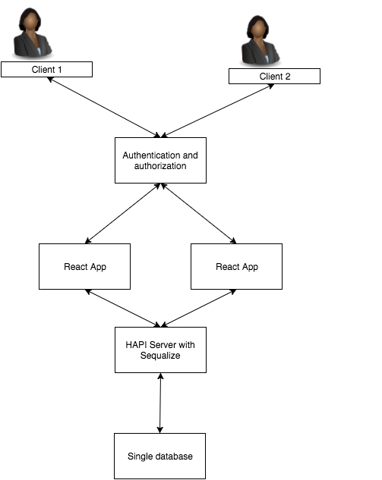
Multi-Tenancy with Logical data separation

Slide 7

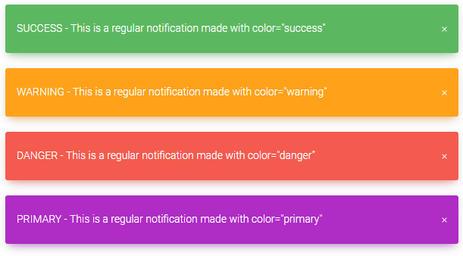
Notification CMS/Control panel
Notification States
Background:
Border:
Font:
Color
Image
Repeat
red
Abc.png
yes
Color
Width
Radius
Light blue
1px
0px
Color
Size
Style
white
12px
Bold

